Slide 1
Office 365 development

Slide 2
Deep dive into Office 365 API for contact

Slide 3
Agenda
Overview
CRUD support
Batching support
Exchange operations using REST

Slide 4
Developer vision

Slide 5
1
Overview

Slide 6
Microsoft Graph for Calendar, Mail and Contacts
Microsoft Graph
Mail Messages
Contacts
Calendar Events
Microsoft Graph accessible through REST
https://graph.microsoft.com/v1.0/me/messages
https://graph.microsoft.com/v1.0/me/contacts
https://graph.microsoft.com/v1.0/me/events

Slide 7
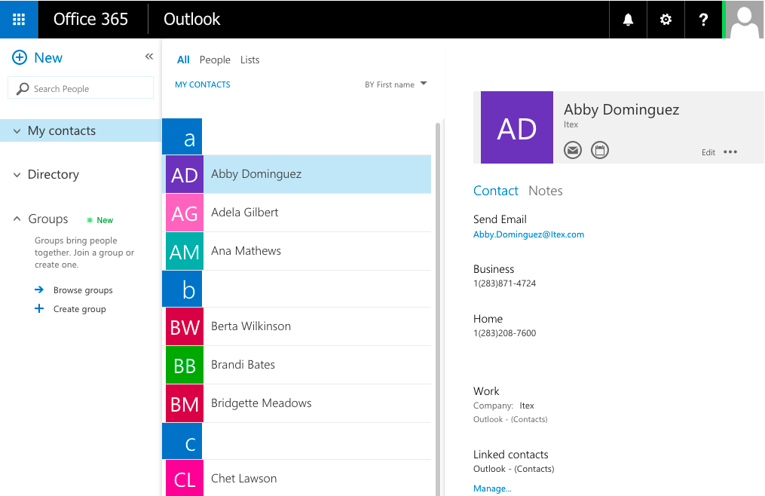
Mailbox contacts
Common API operations
Creating contacts
Deleting contacts
Editing contacts

Slide 8
2
CRUD support

Slide 9
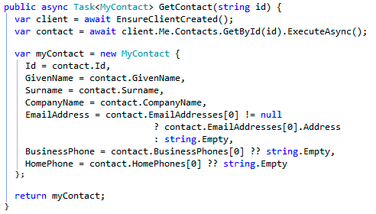
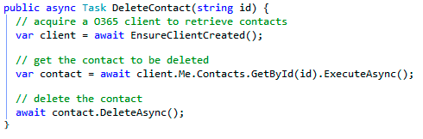
Getting and deleting a specific entity
Contact retrieved by calling GetById(id)
Contact deleted by calling DeleteAsync() on contact object

Slide 10
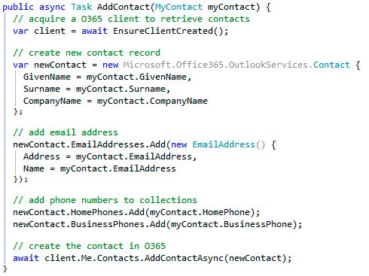
Adding an entity
Call AddContactAsync() on contacts collection

Slide 11
Update operations with the OutlookServicesClient
3 CRUD support
demo

Slide 12
3
Batching with REST

Slide 13
REST is more chatty than CSOM
Each action is sent as a separate request
CSOM allows for multiple requests to be sent as one
Requests are expensive and slow your app

Slide 14
Batching support added to O365
Office 365 REST APIs shipped with support for support with REST APIs
Batching requests with REST support added to SharePoint Online late 2014
Send multiple write & read operations in one HTTP request
SharePoint 2013 on-premises——not supported

Slide 15
Exploring the impact

Slide 16
Overview—Batch request
BATCH REQUEST
CHANGESET – HTTP POST
CHANGESET – HTTP PATCH
CHANGESET – HTTP DELETE
HTTP GET

Slide 17
Overview—Batch response
BATCH RESPONSE
CHANGESET RESPONSE
CHANGESET RESPONSE
CHANGESET RESPONSE
HTTP GET RESPONSE

Slide 18
4
Exchange operations with REST

Slide 19
Microsoft Graph
https://graph.microsoft.com/v1.0/me/drive/root/children
https://graph.microsoft.com/v1.0/me/messages
https://graph.microsoft.com/v1.0/me/events
https://graph.microsoft.com/v1.0/me/events(<event_id>)
https://graph.microsoft.com/v1.0/me/calendar
https://graph.microsoft.com/v1.0/me/calendar/events
https://graph.microsoft.com/v1.0/me/calendars(<calendar_id>)/events
https://graph.microsoft.com/v1.0/me/contacts
https://graph.microsoft.com/v1.0/me/contacts(<contact_id>)

Slide 20
Reading Entities using REST
HTTP GET request to collection or entity endpoint
Microsoft Graph only returns JSON responses
Paging is accomplished using $skip and $top
public async Task<List<MyContact>> GetContacts(int pageIndex, int pageSize)
{
var contactsResults = new List<MyContact>();
var accessToken = await GetGraphAccessTokenAsync();
var restURL = string.Format("{0}me/contacts?$top={1}&$skip={2}", SettingsHelper.GraphResourceUrl, pageSize, pageIndex * pageSize);
using (HttpClient client = new HttpClient())
{
var accept = "application/json";
client.DefaultRequestHeaders.Add("Accept", accept);
client.DefaultRequestHeaders.Authorization = new AuthenticationHeaderValue("Bearer", accessToken);
using (var response = await client.GetAsync(restURL))
{
if (response.IsSuccessStatusCode) {
var jsonresult = JObject.Parse(await response.Content.ReadAsStringAsync());
foreach (var item in jsonresult["value"]) {
contactsResults.Add(new MyContact
{
Id = !string.IsNullOrEmpty(item["id"].ToString()) ? item["id"].ToString() : string.Empty,
GivenName = !string.IsNullOrEmpty(item["givenName"].ToString()) ? item["givenName"].ToString() : string.Empty,
…
});
}
}
}
}
MorePagesAvailable = contactsResults.Count < pageSize ? false : true;
return contactsResults;
}
Notes:
No support for $skip and $orderby so paging is post-query

Slide 21
Adding a new Entity
HTTP POST to collection endpoint to add an entity
public async Task AddContact(MyContact myContact)
{
var accessToken = await GetGraphAccessTokenAsync();
var restURL = string.Format("{0}me/contacts", SettingsHelper.GraphResourceUrl);
try
{
using (HttpClient client = new HttpClient())
{
var accept = "application/json";
client.DefaultRequestHeaders.Add("Accept", accept);
client.DefaultRequestHeaders.Authorization = new AuthenticationHeaderValue("Bearer", accessToken);
string postBody = JsonConvert.SerializeObject(myContact);
using (var response = await client.PostAsync(restURL, new StringContent(postBody, Encoding.UTF8, "application/json")))
{
if (response.IsSuccessStatusCode)
return;
else
throw new Exception("add contact error: " + response.StatusCode);
}
}
}
catch (Exception el)
{
el.ToString();
}
}

Slide 22
Deleting an Entity
HTTP DELETE to specific entity endpoint
public async Task DeleteContact(string id)
{
var accessToken = await GetGraphAccessTokenAsync();
var restURL = string.Format("{0}me/contacts('{1}')", SettingsHelper.GraphResourceUrl, id);
try
{
using (HttpClient client = new HttpClient())
{
var accept = "application/json";
client.DefaultRequestHeaders.Add("Accept", accept);
client.DefaultRequestHeaders.Authorization = new AuthenticationHeaderValue("Bearer", accessToken);
using (var response = await client.DeleteAsync(restURL))
{
if (response.IsSuccessStatusCode)
return;
else
throw new Exception("delete contact error: " + response.StatusCode);
}
}
}
catch (Exception el)
{
el.ToString();
}
}

Slide 23
Exchange operations using the Office 365 REST APIs
4 Exchange operations with REST
demo

Slide 24
Summary
Overview
CRUD support
Batching support
Exchange operations using REST

Slide 25
Developer Program launch
1 YEAR FREE
Email Newsletters
Free Developer Subscription
Free Training
Free Tools
Webinars
http://dev.office.com/devprogram

Slide 26
Engage

